Slide 2
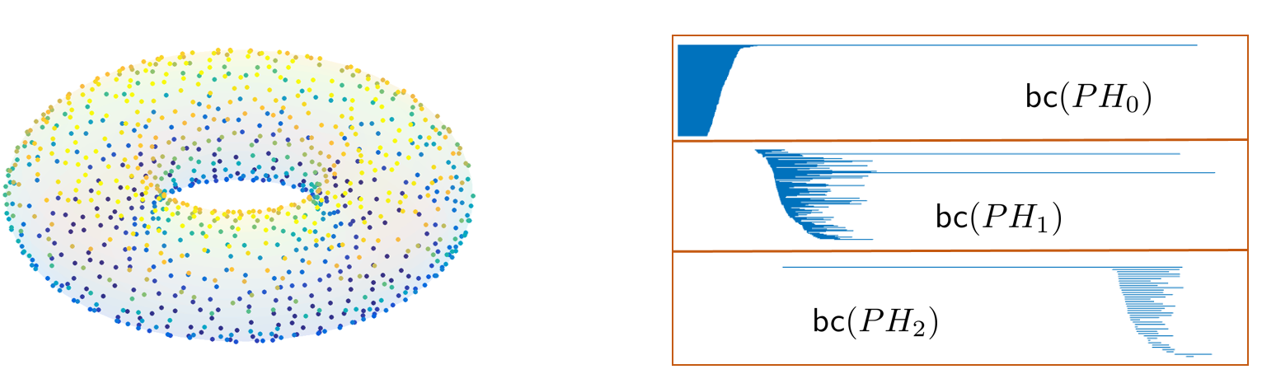




Slide 4
Protein Classification Benchmark Collection
(PCB00019) – SCOP40mini
1,357 proteins | # atoms ~ 1K | 55 classification tasks
A protein classification benchmark collection for machine learning, P. Sonego et. al., Nucleic acids research, 2007.

Slide 5
L. Polanco and J. A. Perea, Adaptive template systems: Data-driven feature selection for learning with persistence, ICMLA 2019

Slide 6
Methodology

Slide 7
Transformer Examples
Dimension Reduction
Sliding Windows
Community Accepted Features
Your favorite method

Slide 8
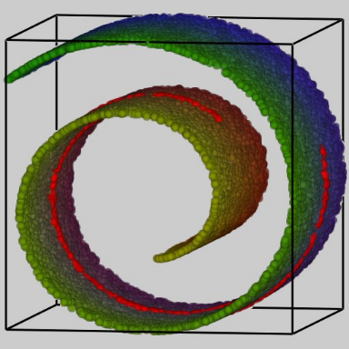
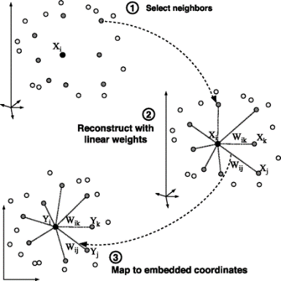
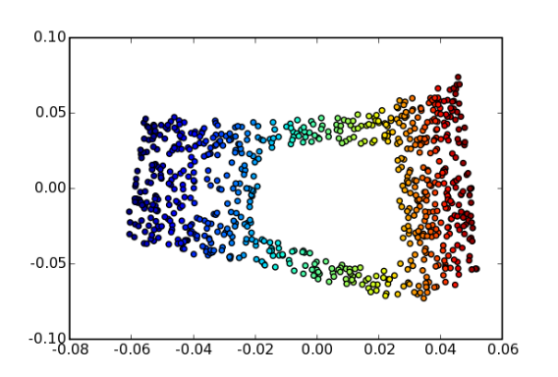
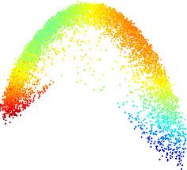
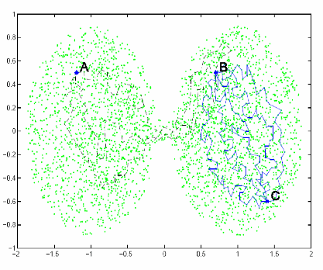
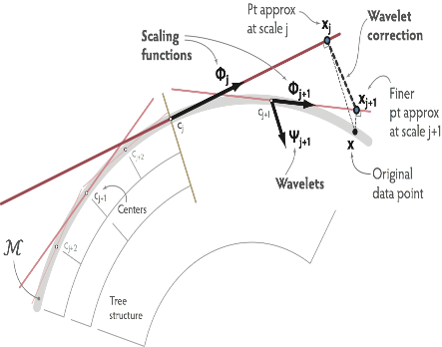
Dimension Reduction
Isomap
LLE
Hessian LLE
Laplacian
Eigenmaps
Diffusion
Geometry
Local PCA

Slide 9

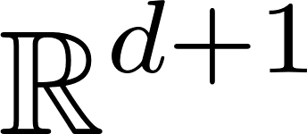
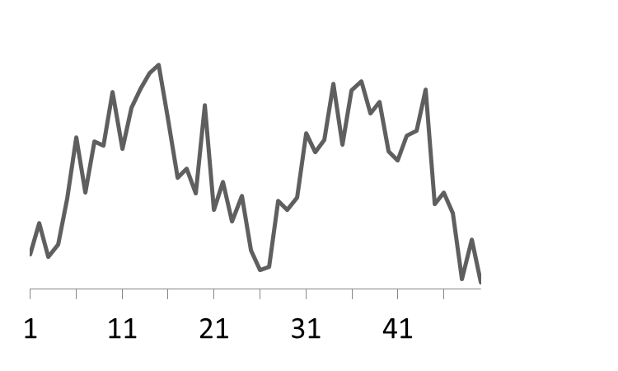
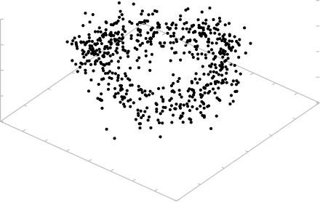

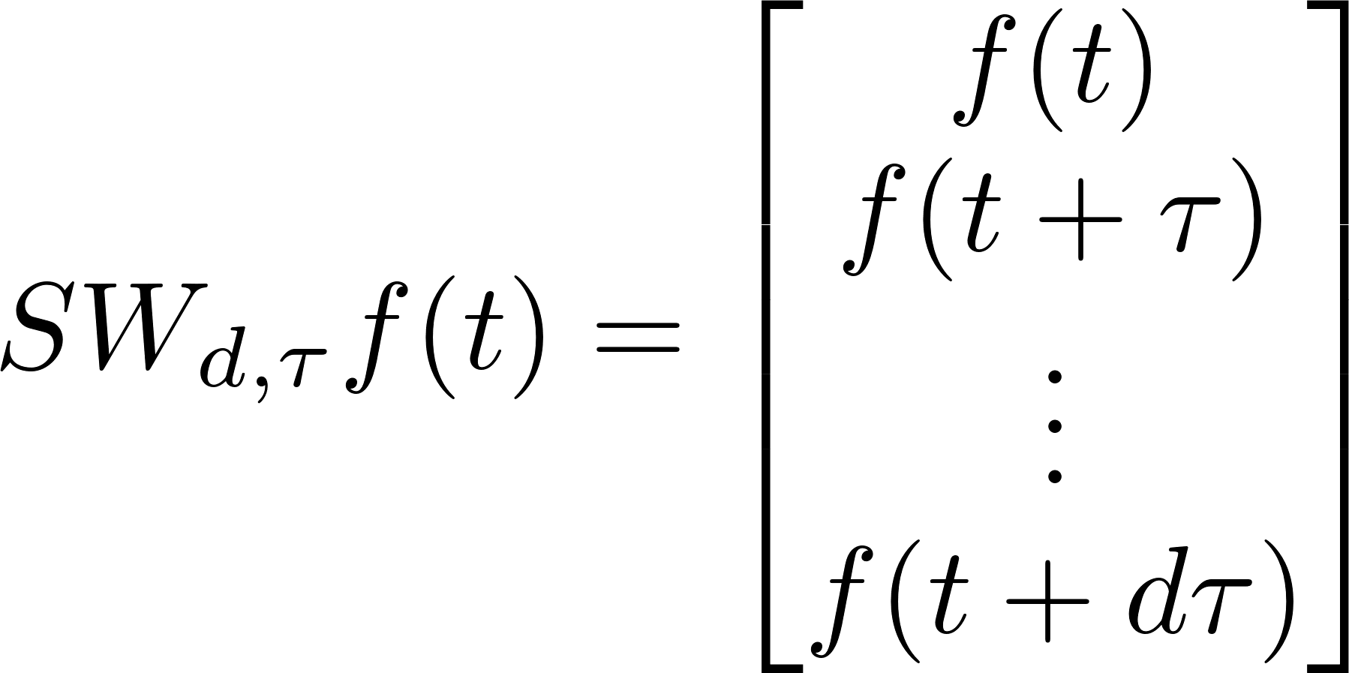

Sliding Windows (Delay Reconstruction)
Notes:
time series with N observations, spline it and construct its sliding window point cloud. Say we are looking for L perioids,
the theory suggests parameters. compute 1-persistence, and maximum persistence is the score. sometimes 1- normalized score.
Why do biologists like this method : shape agnostic and amenable to denoising.

Slide 10
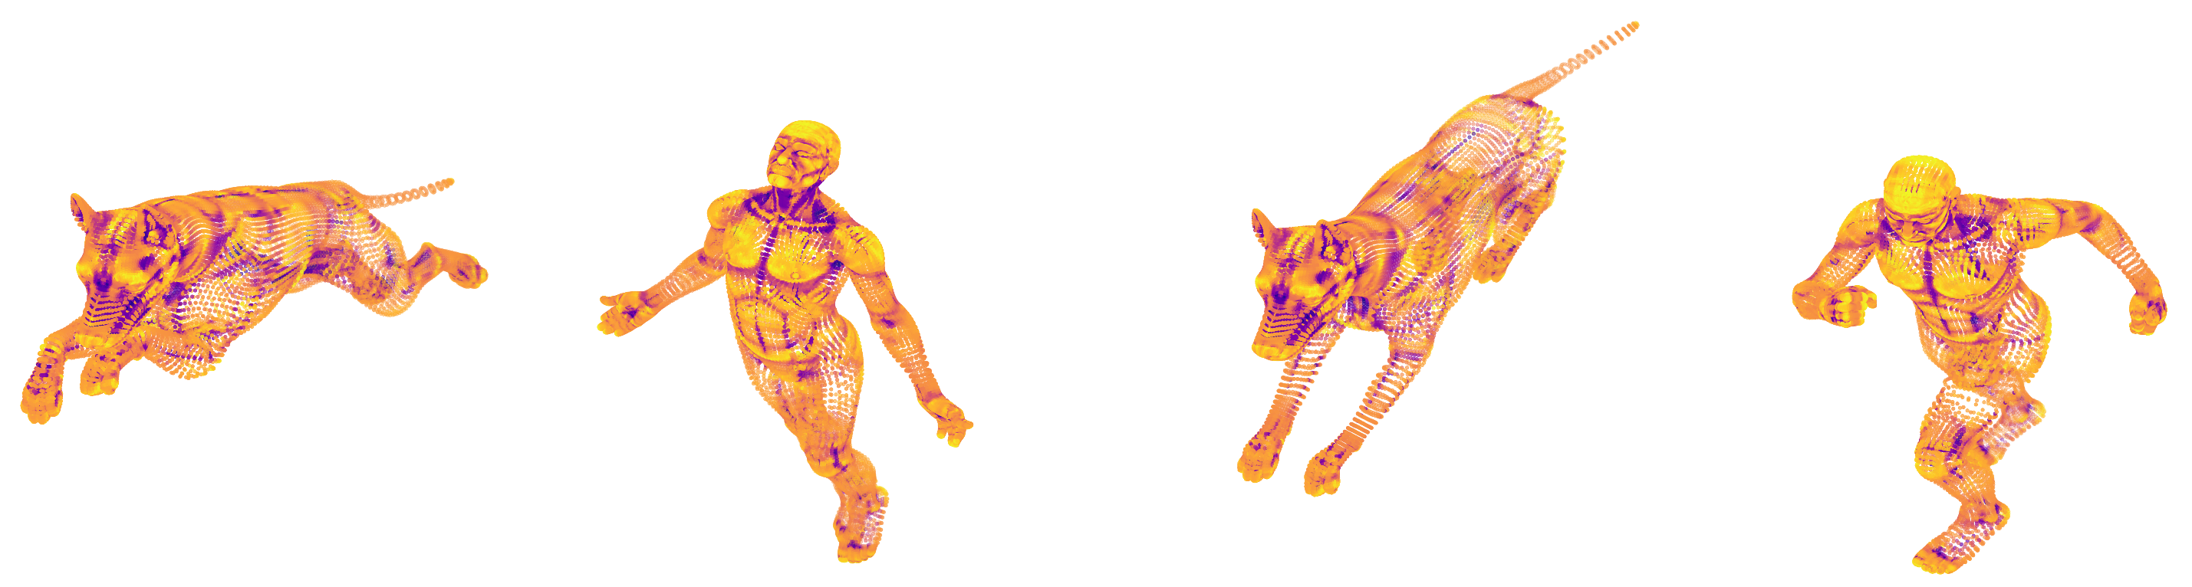
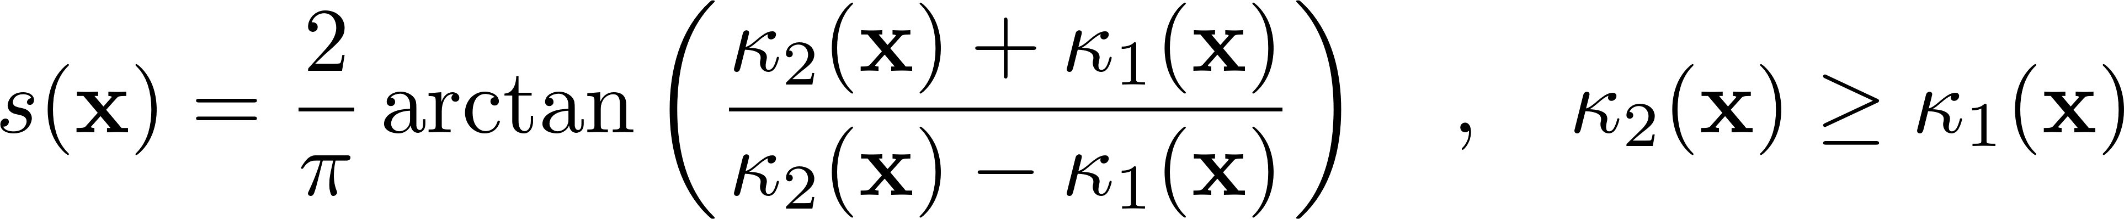
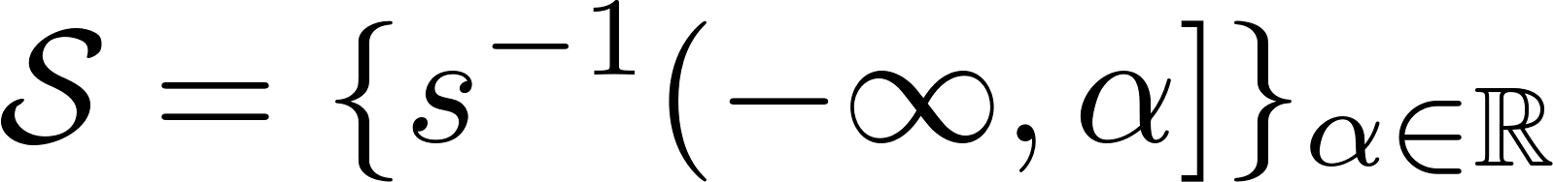

TOSCA data set
Shape index:
Sublevelset filtration
Persistence diagrams

Slide 11
Image
Freudenthal Triangulation

Slide 14
Methodology

Slide 16
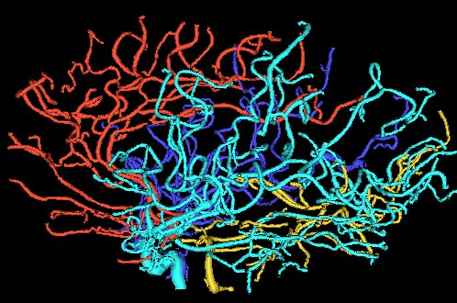
Brain Vasculature Age (and Gender)
Bendich
Marron
Miller
Pieloch
Skwerer
Notes:
Brain vessels from Liz Bullitt at UNC
Technology is MRA (Magnetic Resonance Angiography) followed by tube-tracking
98 healthy subjects divided equally by gender. Ages 18-72
Practitioners have intuition on age, health – but NOT ON GENDER

Slide 17
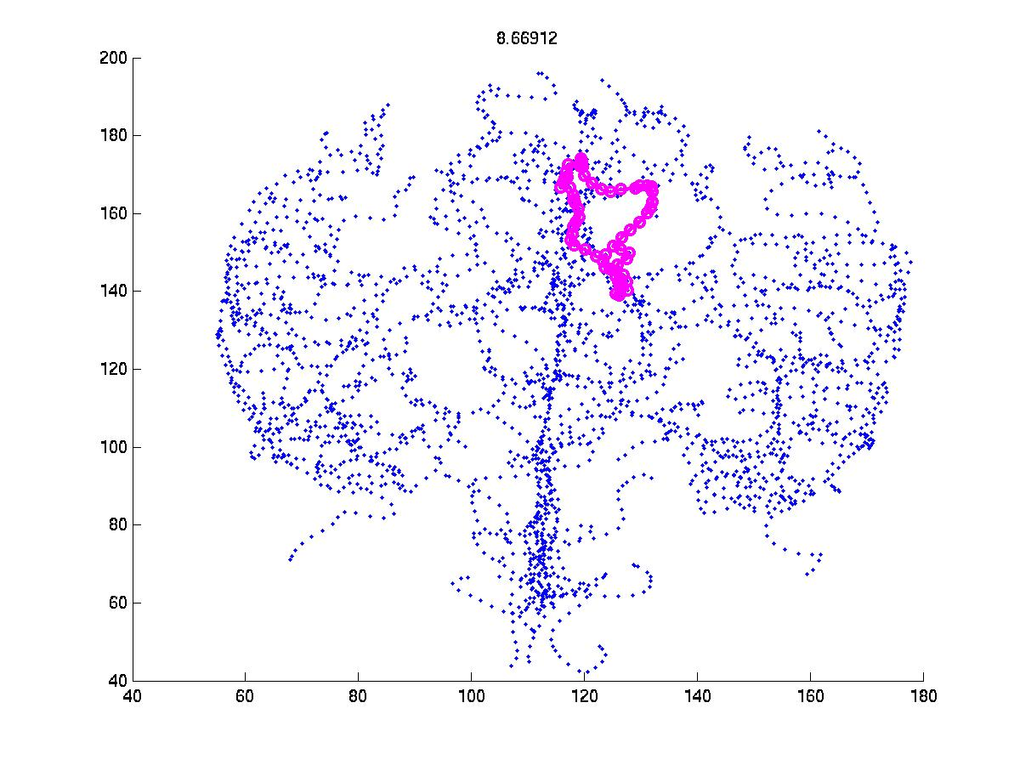
Persistence Features
Example of a 1-cycle
“Medium Size”
0D persistence by height
1D persistence by growth
Feature Extraction
Brain → top 100 persistences
ranked by size
Notes:
Medium scale loops tell you your age.
Age and Gender – Paul will discuss at Penn next Monday.
Brain → top 100 persistences ranked by size
Brains -> run PCA on these features and select first eigenline and project onto that to get a coordinate
Correlate this with age and it does really well – better than most.

Slide 18
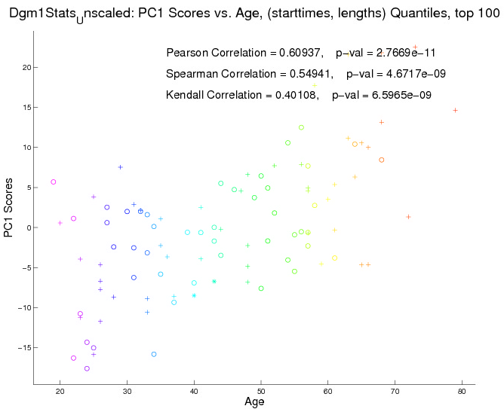
Analysis
Colors are age
Brains -> ran PCA on these features
and selected first eigenvector.
Projected onto that to get a coordinate
called PC1
Correlate this with age and it
does really well – better than
all other known methods.

Slide 21
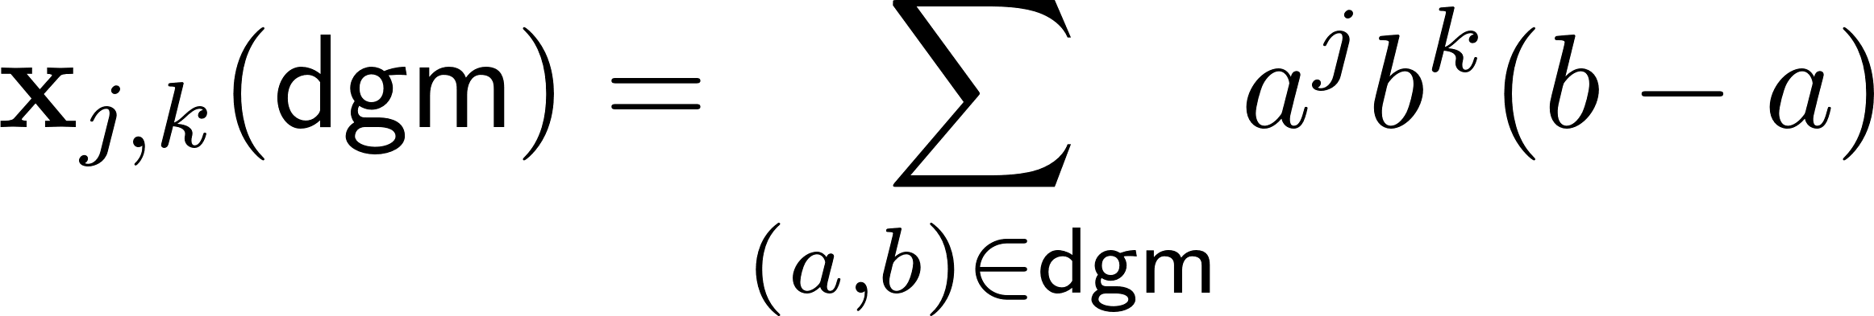
Adcock-Carlsson-Carlsson Coordinates
Positive:
Varying continuously and consistent as number of points changes
(death into diagonal)
May or may not be positive:
Higher emphasis on points further from diagonal

Slide 22
Classification of Hepatic Lesions
A. Adcock
D. Rubin
G. Carlsson

Slide 23
Classification of Hepatic Lesions
A. Adcock
D. Rubin
G. Carlsson
132 images to be classified

Slide 24
Classification of Hepatic Lesions
A. Adcock
D. Rubin
G. Carlsson
Features
132 images to be classified

Slide 25
Classification of Hepatic Lesions

Slide 28




Slide 31
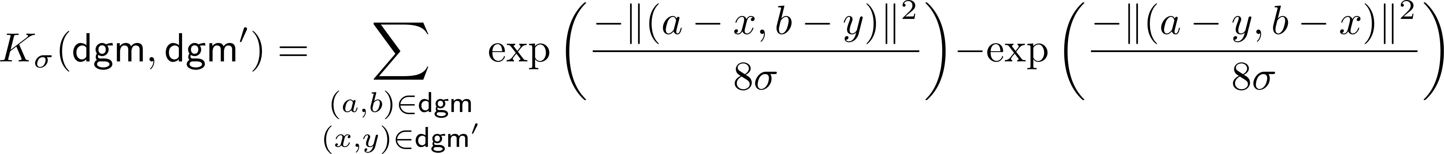

Slide 35



Slide 36






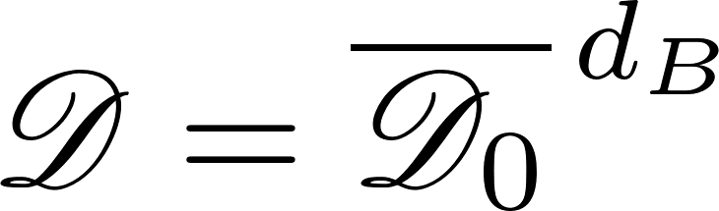
The space of persistence diagrams
(multiplicity)
(metric completion)

Slide 37

Problem:
Given an arbitrary continuous function
approximate it arbitrarily well , in a computationally-feasible manner.
(multiplicity)
(metric completion)

Slide 38

Compactness in
(joint with E. Munch and F. Khasawneh)

Slide 39

Continuous and compactly supported
(multiplicity)
(metric completion)

Slide 40
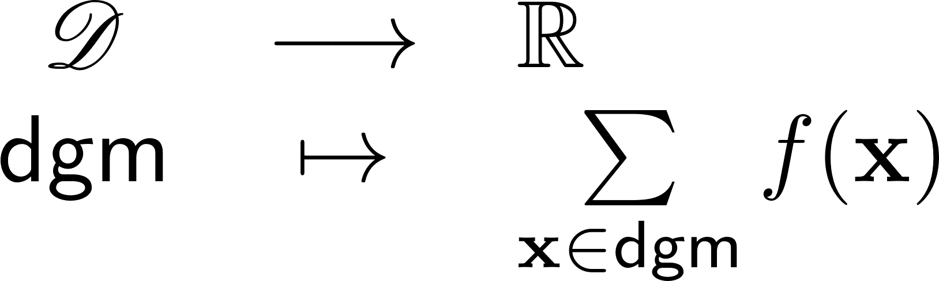
Continuous and compactly supported
Remark:
Is continuous.

Slide 41
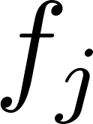
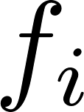
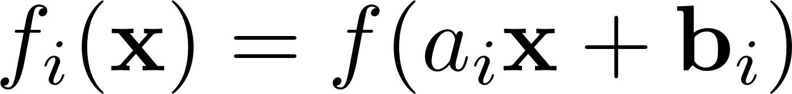
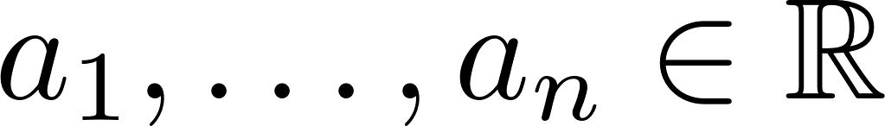
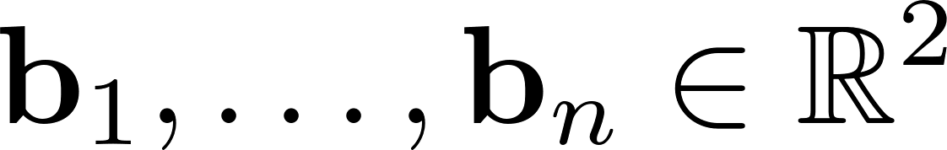
Templates
Continuous and compactly supported
Remark:
Is continuous.

Slide 42




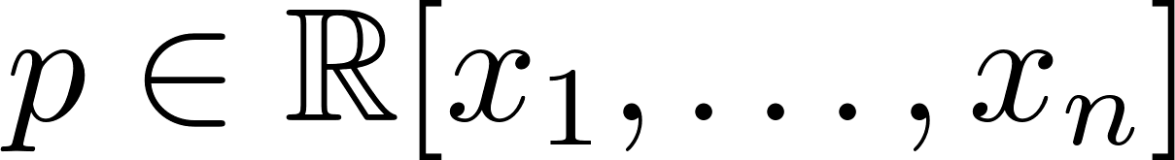
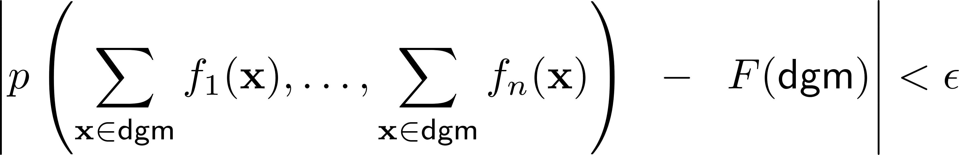

Theorem
Let be compact and let be continuous.
Then, given and nonzero, there exist
and a polynomial so that
for every .
J. A. Perea, E. Munch and F. Khasawneh, Approximating Continuous Functions on Persistence Diagrams, FoCM 2022

Slide 43


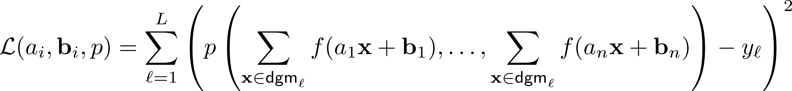
Learning with Templates:
Training data:
Model parameters: , ,
Loss function: For , let

Slide 44
Tent functions

Slide 45
Rossler Atractor

Slide 46
Rossler Atractor

Slide 48
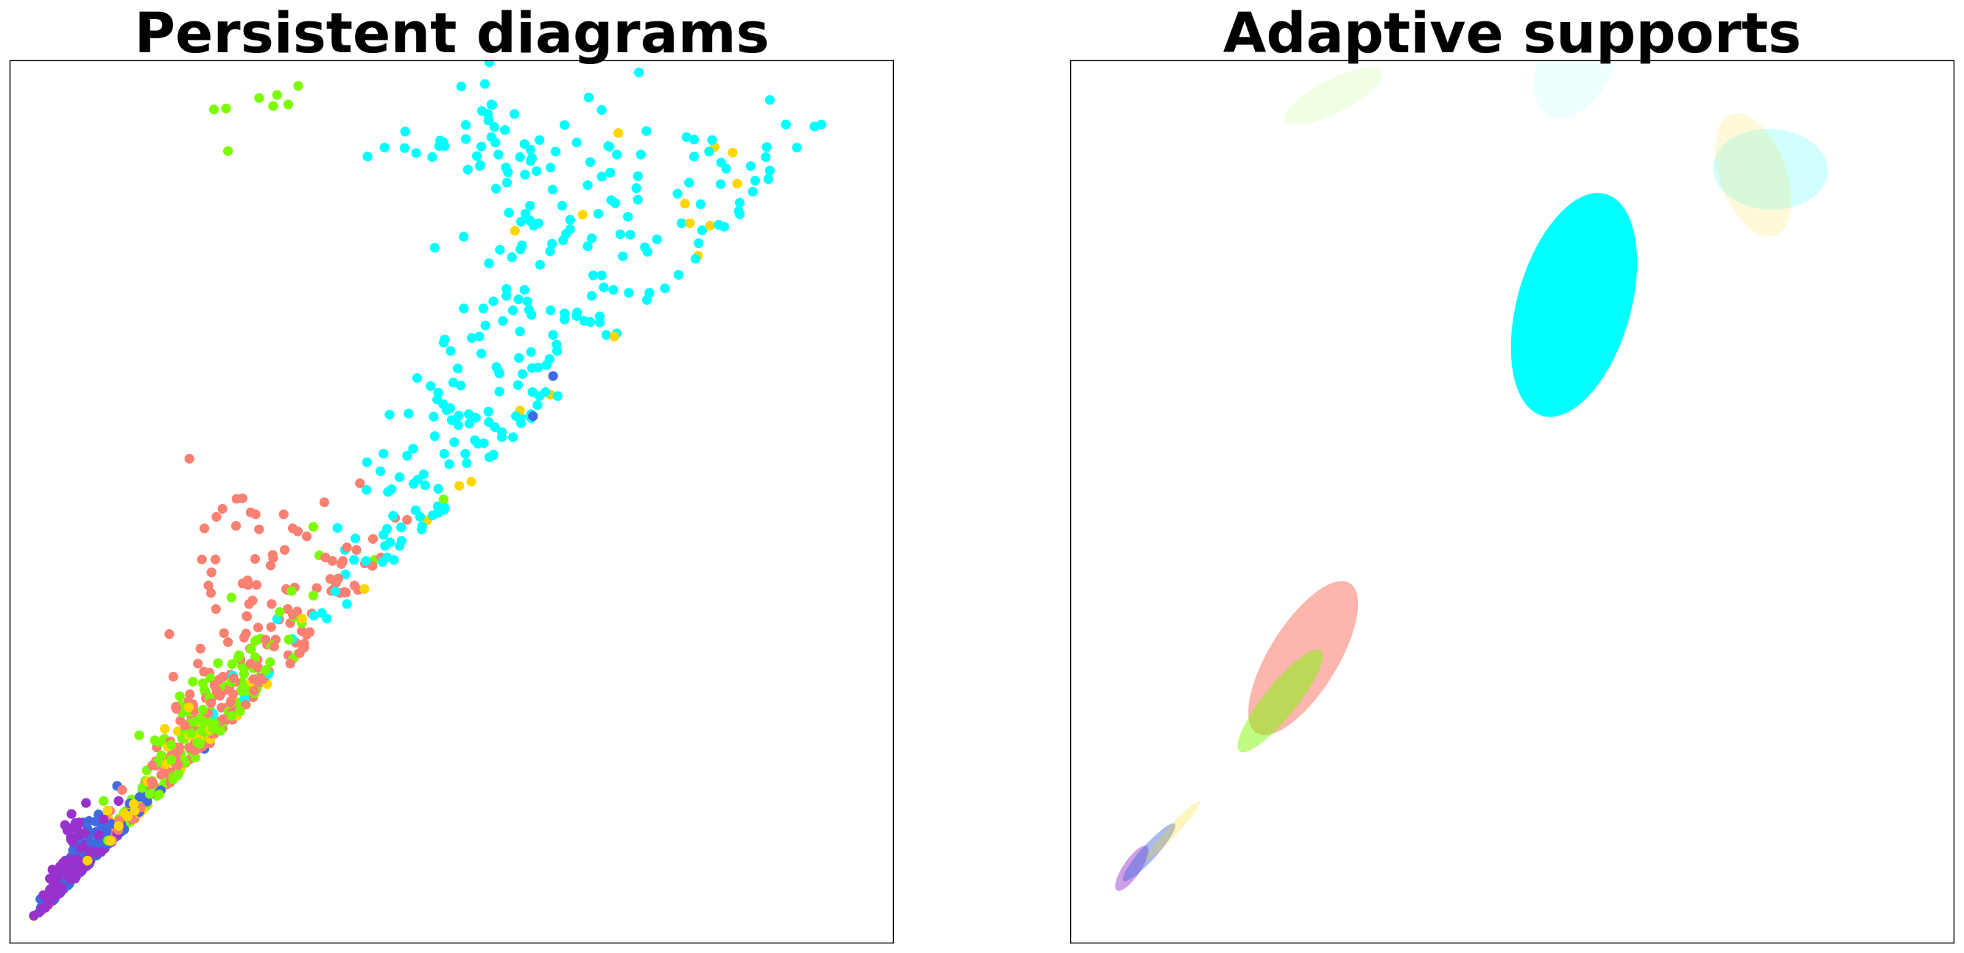
L. Polanco and J. A. Perea, Adaptive template systems: Data-driven feature selection for learning with persistence, ICMLA 2019

Slide 49
Protein Classification Benchmark Collection
(PCB00019) – SCOP40mini
1,357 proteins | # atoms ~ 1K | 55 classification tasks
A protein classification benchmark collection for machine learning, P. Sonego et. al., Nucleic acids research, 2007.

Slide 50
L. Polanco and J. A. Perea, Adaptive template systems: Data-driven feature selection for learning with persistence, ICMLA 2019

Slide 58

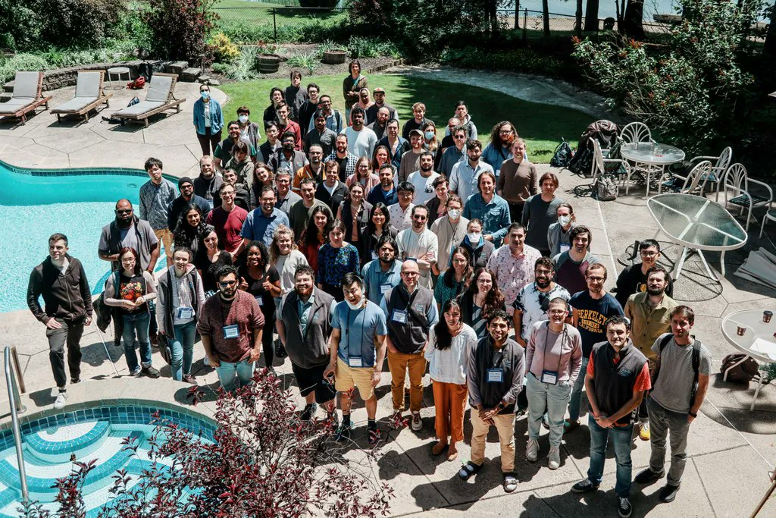

Slide 60
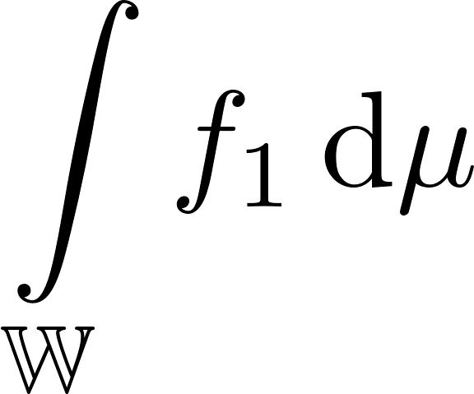
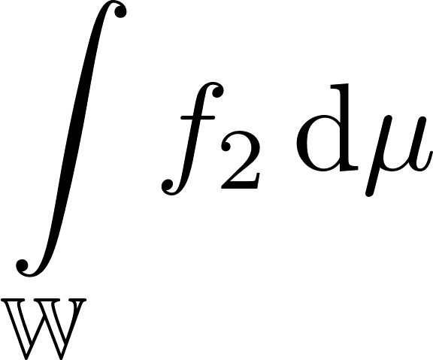
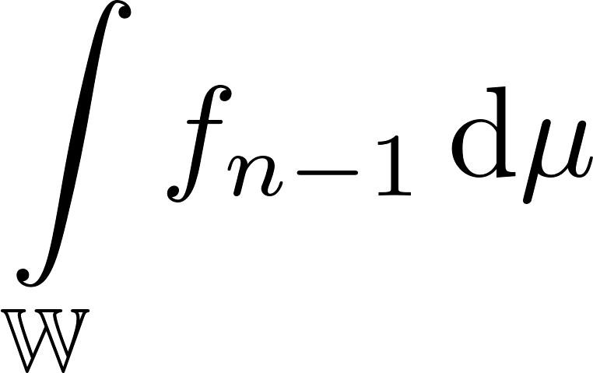
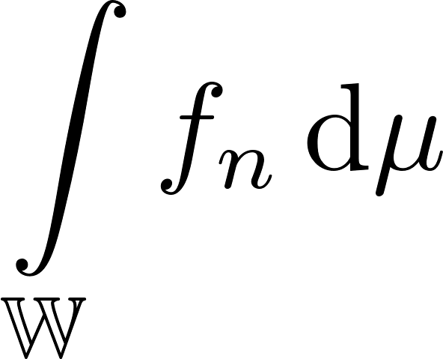

template

Slide 61


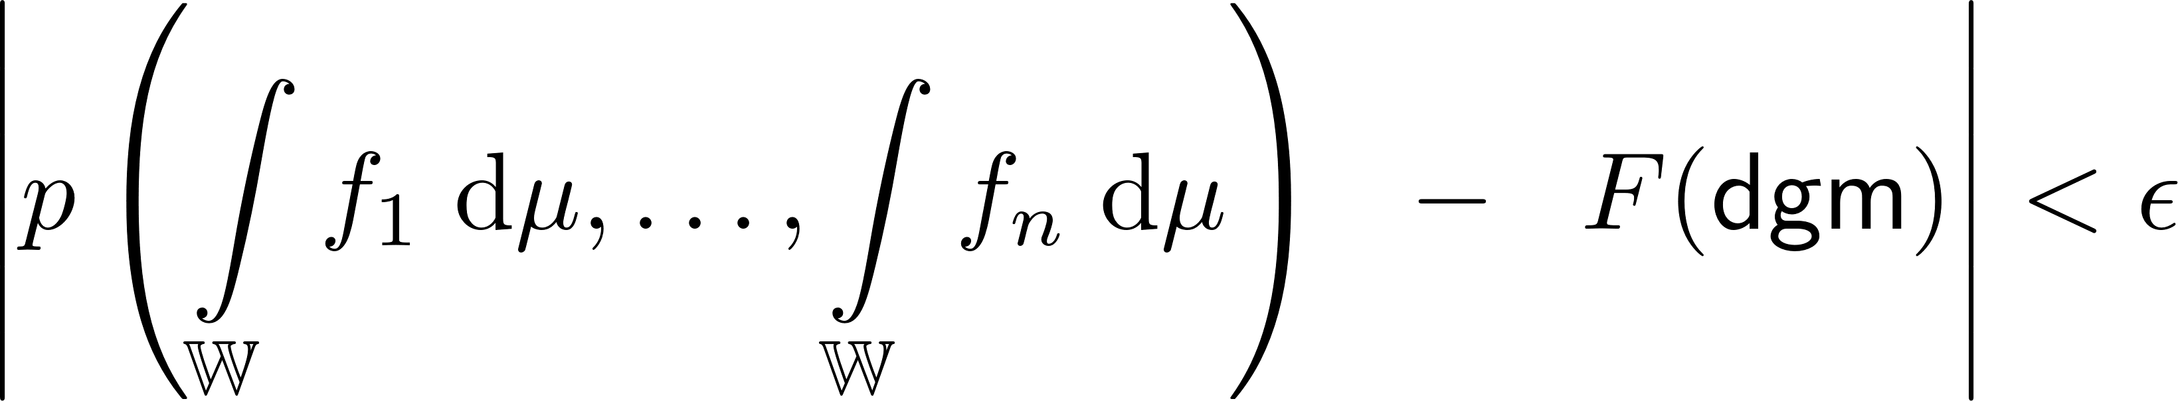

Theorem [Elchesen, Hartsock, P. , Rask]
Let be compact and let be continuous.
Then, given , there exist functions
and a polynomial so that
for every .
A. Elchesen, I. Harstock, J. A. Perea and T. Rask, Learning on Persistence Diagrams as Radon Measures, arXiv 2022

Slide 62
Experiment: Shape classification

Slide 63
Experiment: Texture classification
Sublevel set persistence

Slide 64
Experiment: Texture classification

Slide 65
Experiment: Texture classification

Slide 66
Experiment: Satellite cloud pattern classification

